Slide 1

Cloud Workshop
Cloud Technology Essentials

Slide 2


Outline
Networking
1
2
Cloud
Deployment
3
4
Breakout
More on Cloud
5
6
Q & A

Slide 3
?
What did just happened?

Slide 4




Networking
Essential Basics
How information is transmitted over computer networks, network architecture, HTTP, APIs, and web applications
Notes:
Please, replace the image with a more suitable. Avoid removing the blue shape!

Slide 5

Networking Objectives
🥚 Basic
🥚 Layers of Networking
🥚 Data exchange in the Internet
🥚 Web applications
✔️ Advanced
✔️ Requests and responses ✔️ API
✔️ Flask

Slide 6
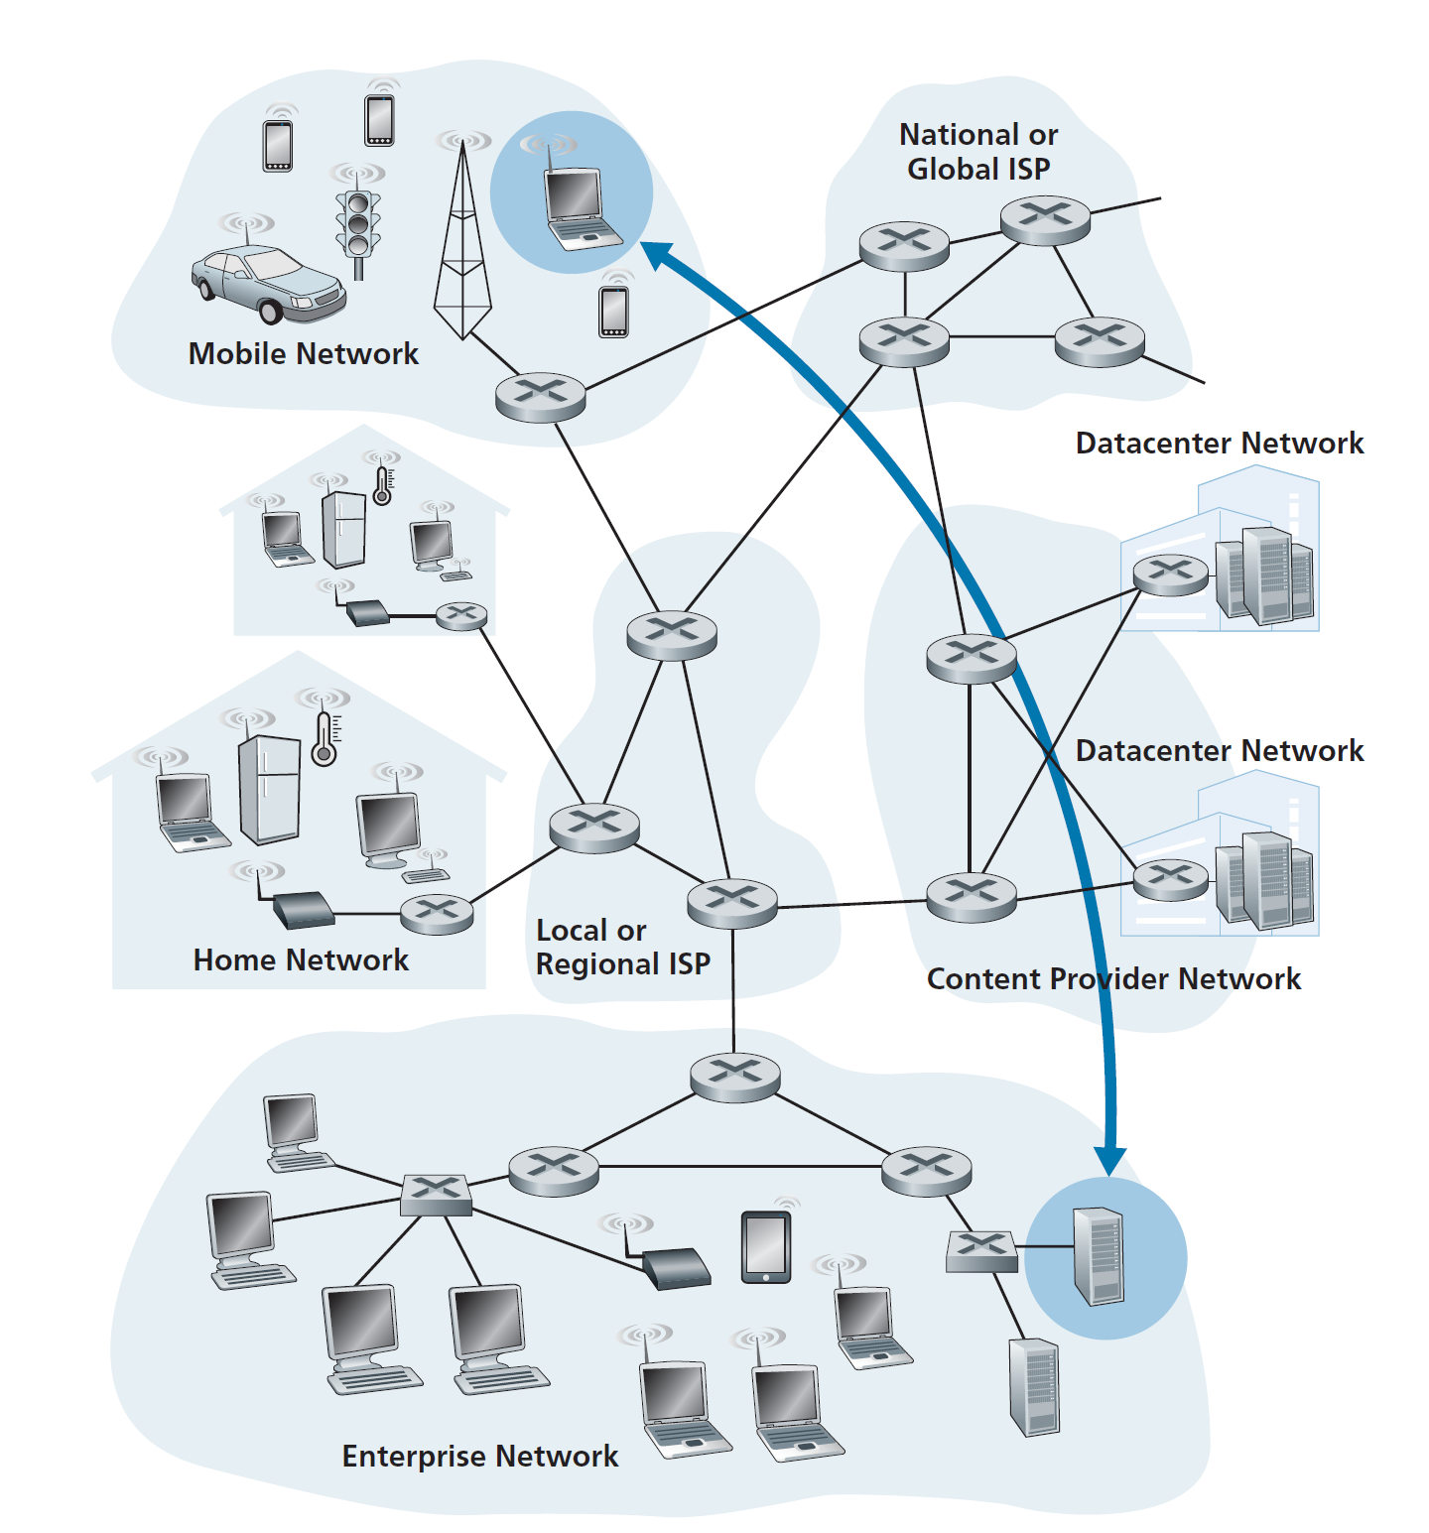

Slide 7
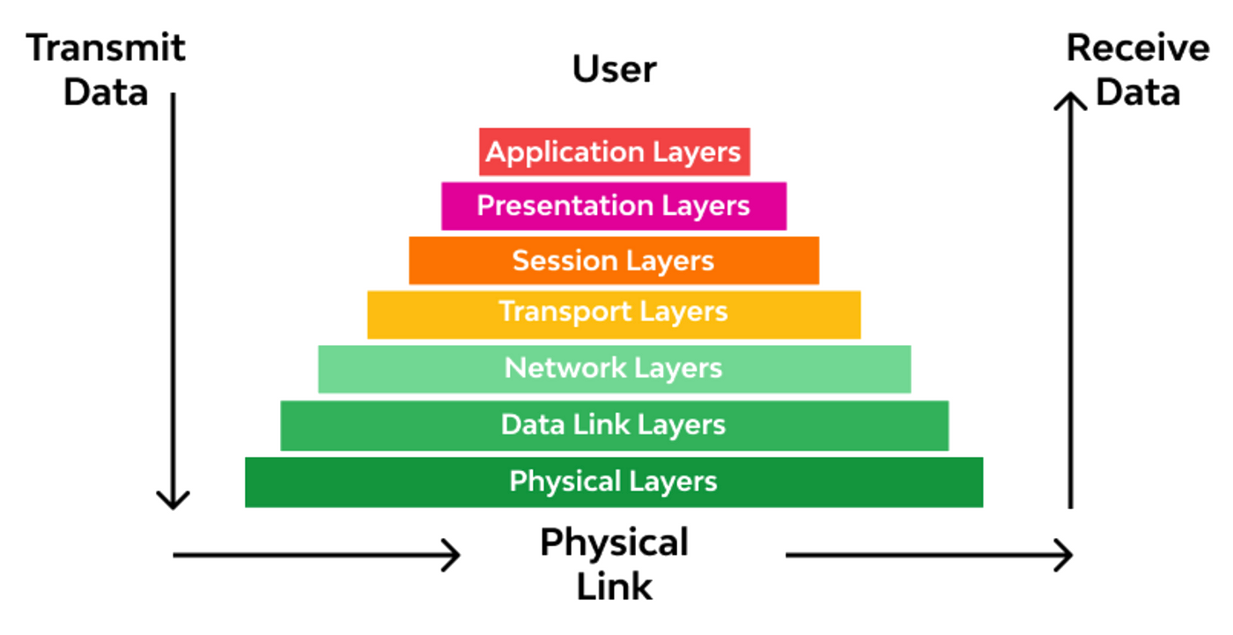
Layers of Networking

Slide 8
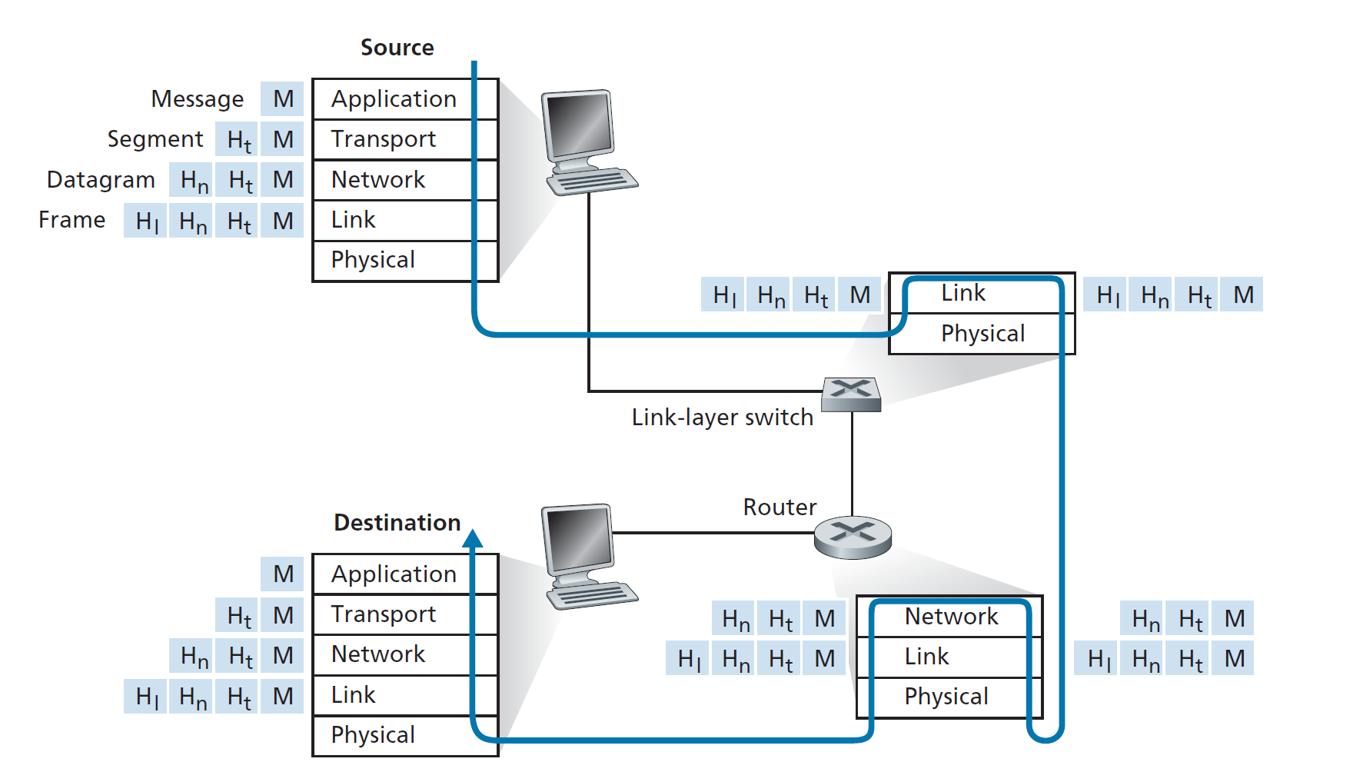

Slide 9
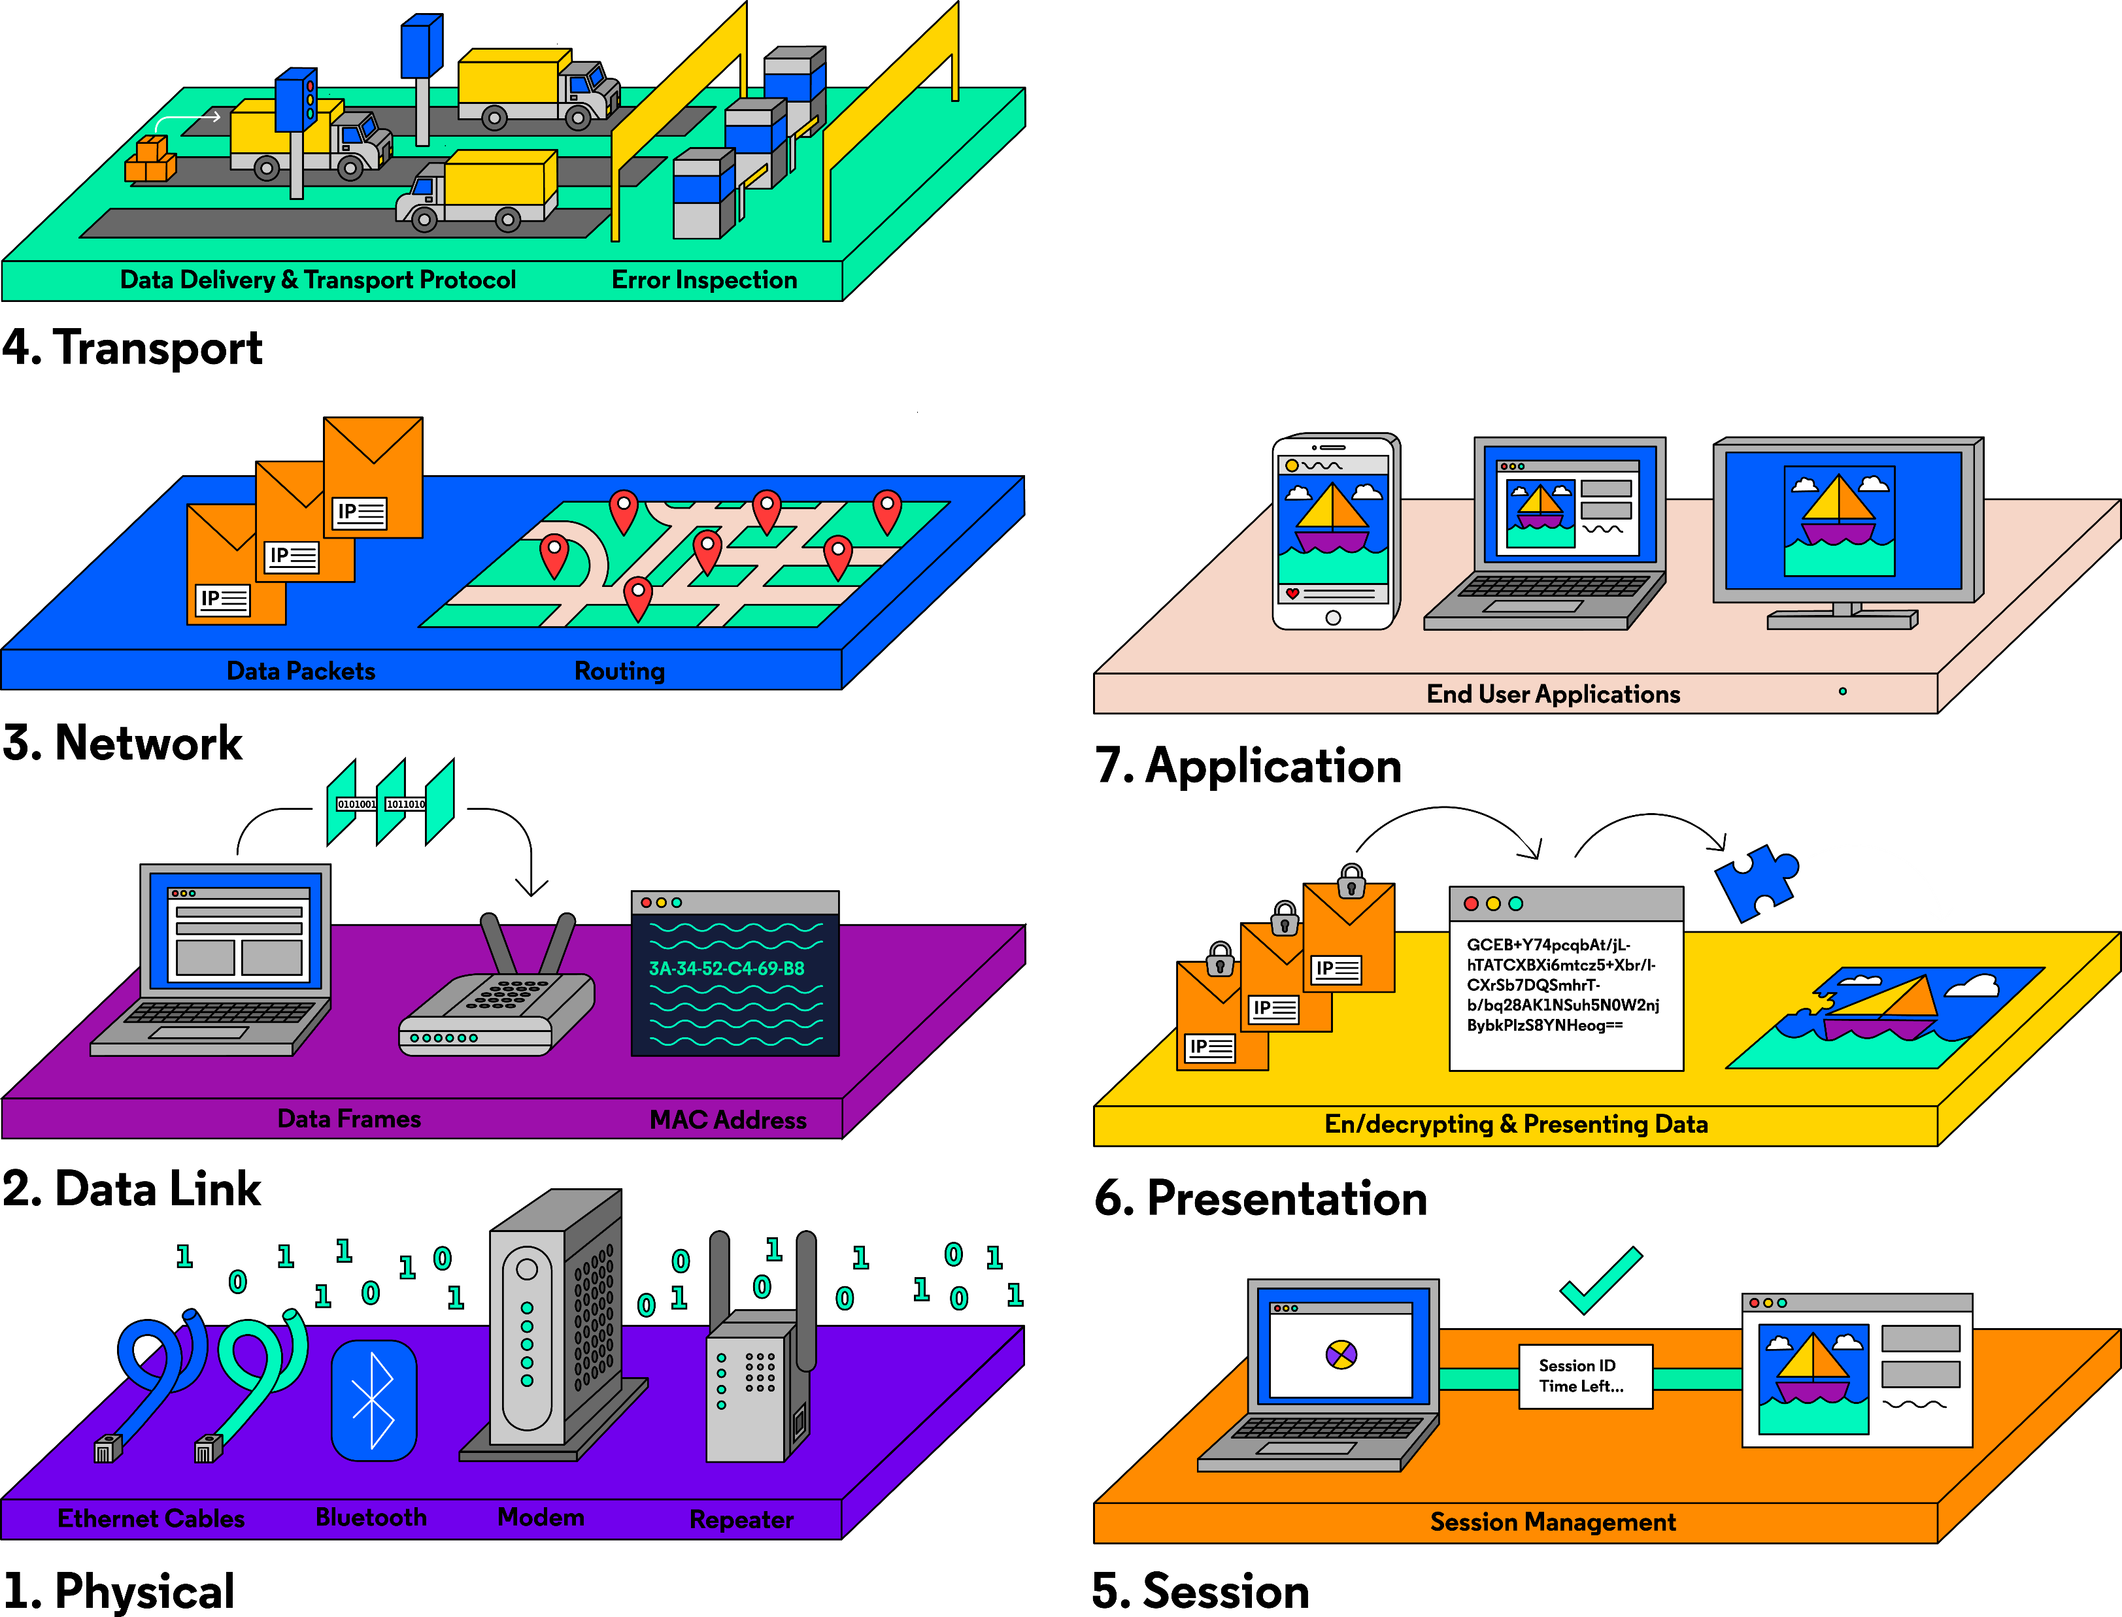

Slide 10
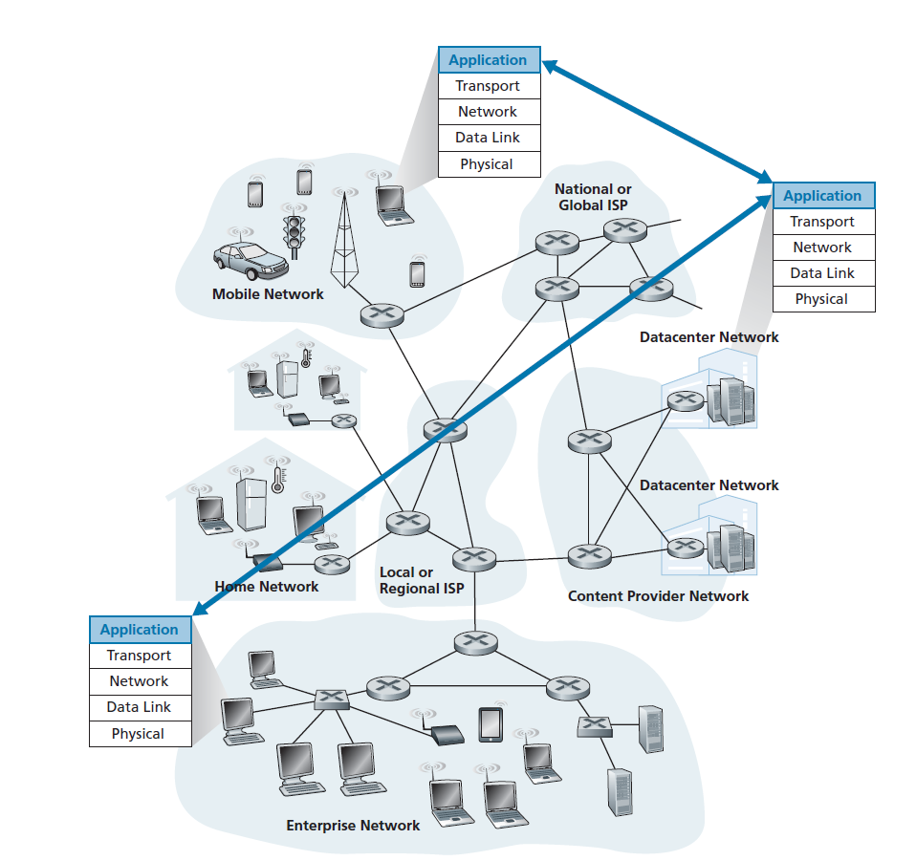

Network Architecture
End-system interaction

Slide 11
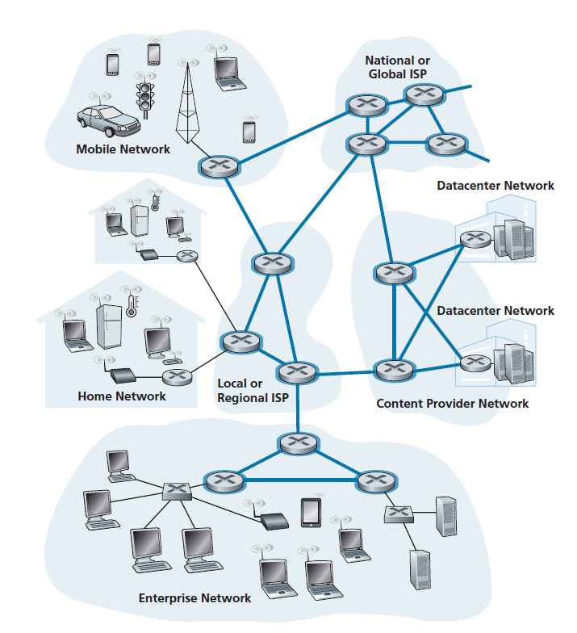
Network core

Slide 12
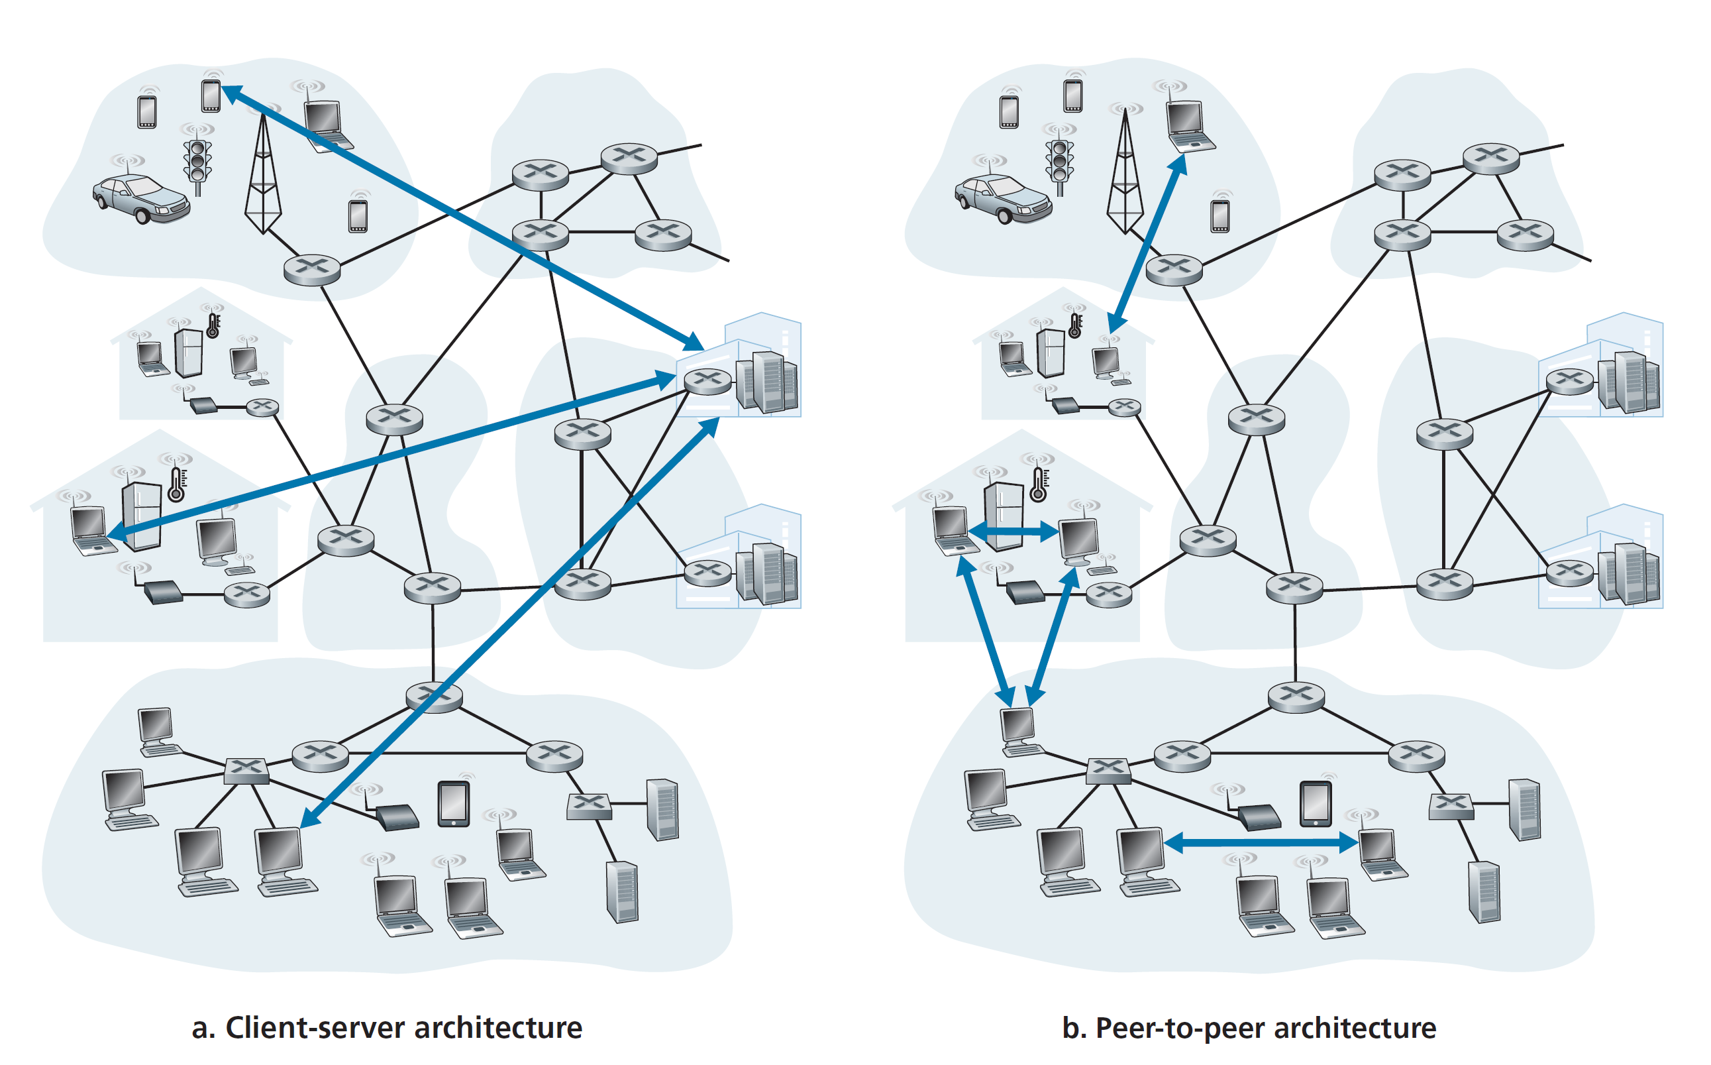

Slide 13

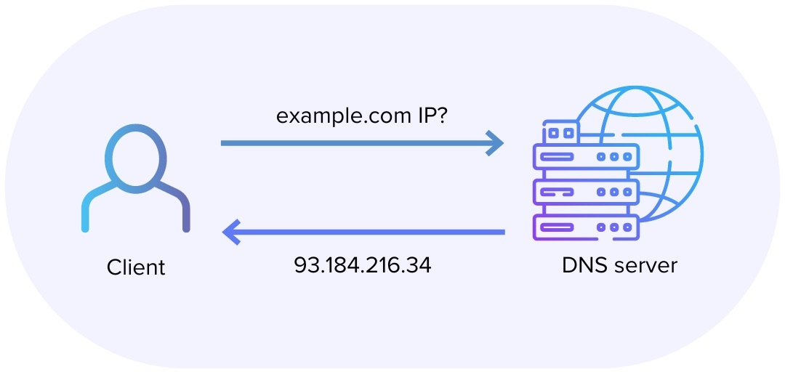
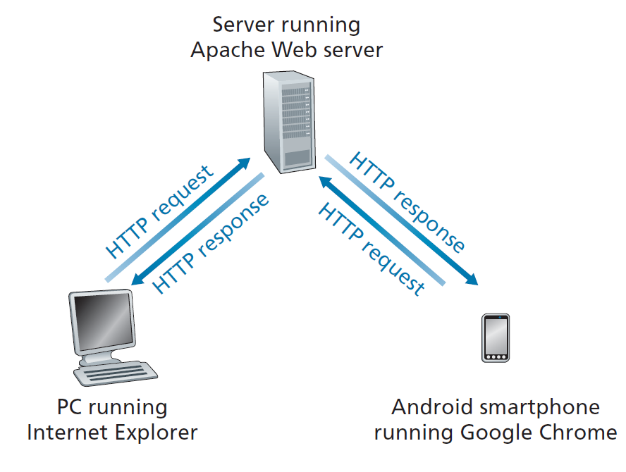
Request - Response
HTTP Methods:
GET, POST, PUT, DELETE

Slide 14
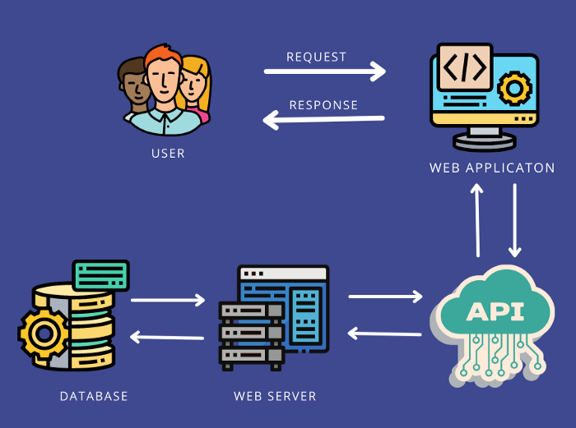
Web Application

Slide 15
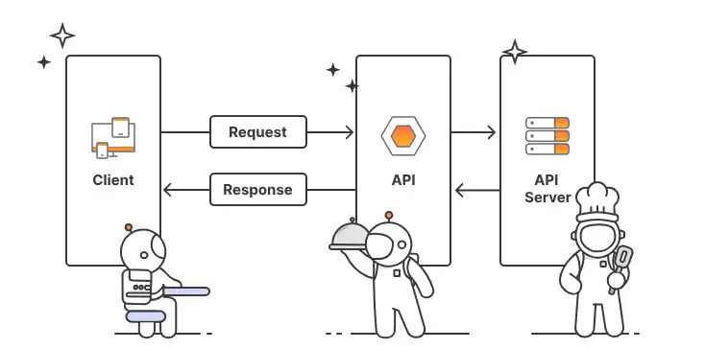
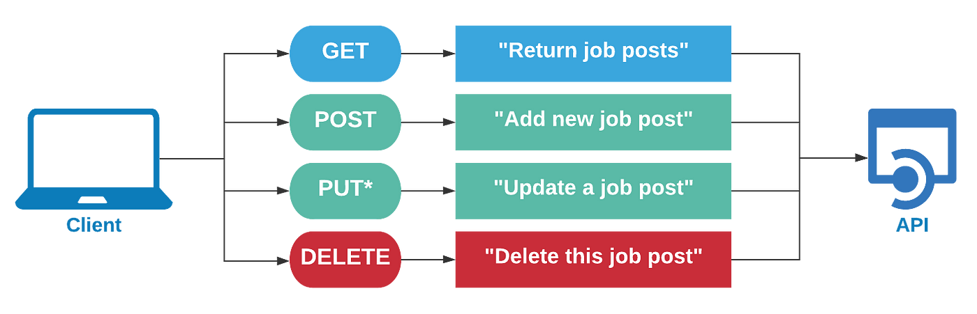
API

Slide 16
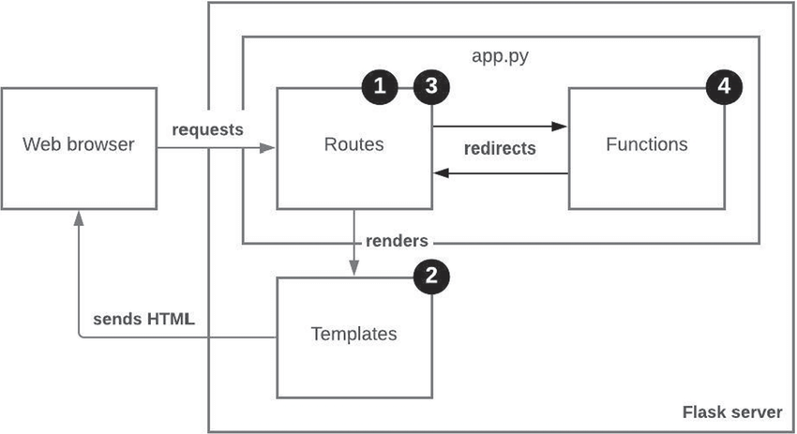
Flask
Flask - Python framework for web application

Slide 17
“
If you are a data scientist do you need to know about networking?
Discussion

